Slide 1
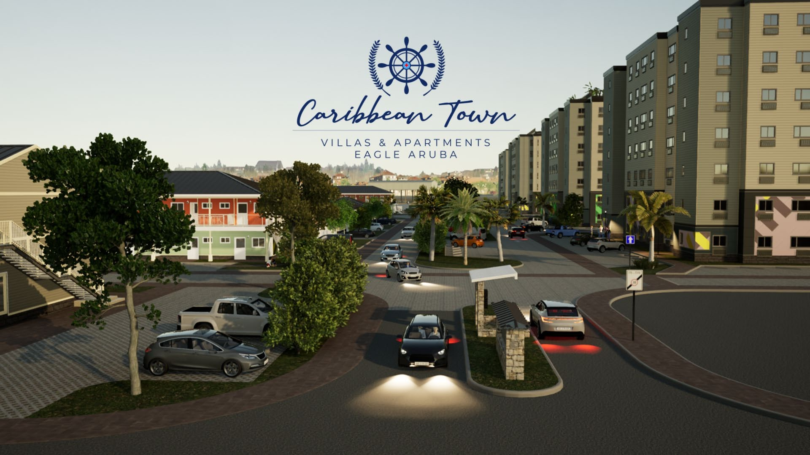

Slide 2
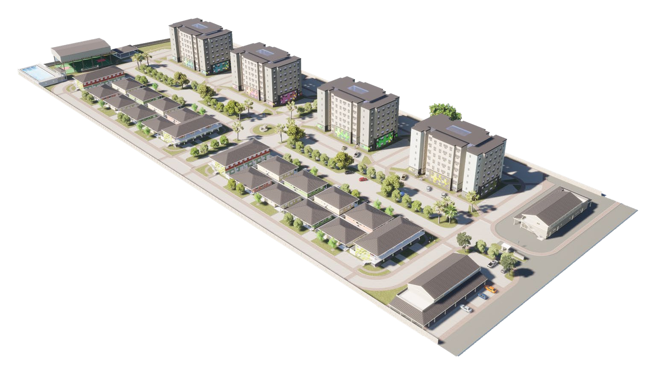
328 UNITS
9 MODELS
42,000 MT2
2 PHASES
PHASE 1 DELIVERING Q2 2025
PHASE 2 DELIVERING End of 2025
EAGLE AREA
RESIDENTIAL & GATED COMMUNITY
OUTDOOR FITNESS + JOGGING ROUTE
POOL + PLAYGROUND + RECREATION AREA+ PET PARK
ARTISTIC COMPONENT
SUSTAINABLE & INNOVATIVE
COMMERCIAL AREA
FACILITIES BUILDING
PROPERTY MANAGEMENT

Slide 3
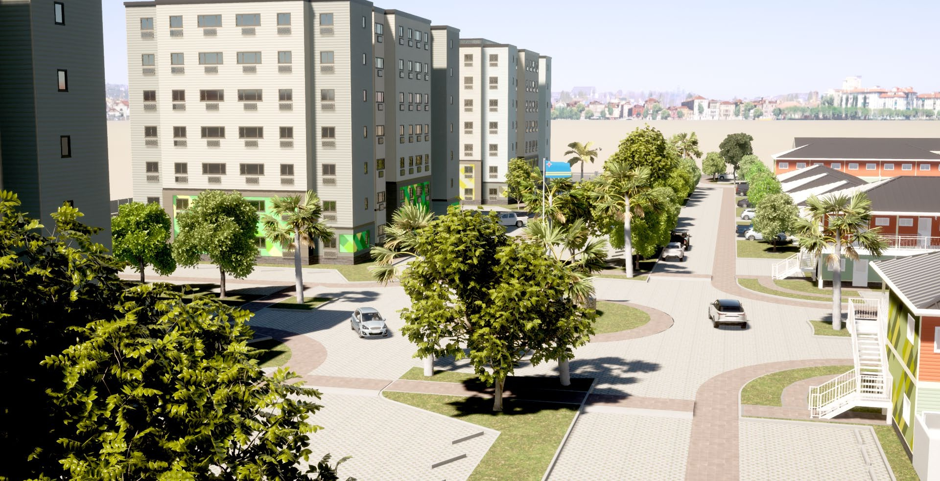
Apartments

Slide 4
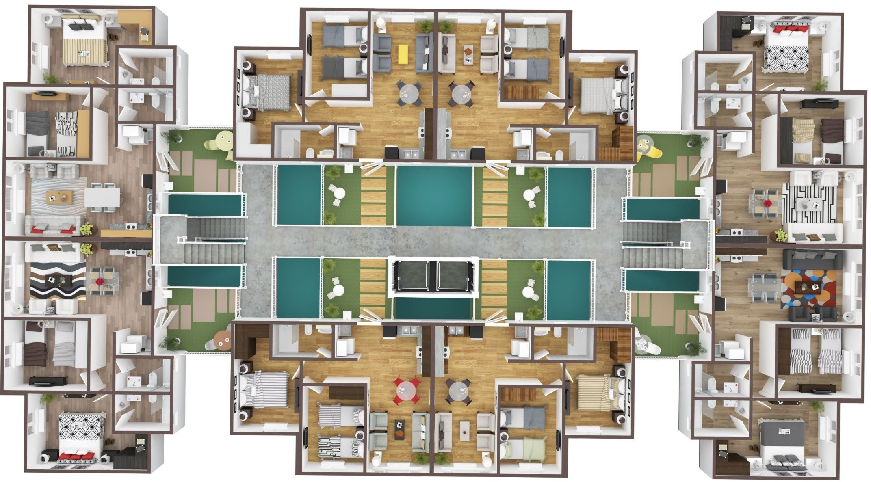
Turks & Caicos Building Layout

Slide 5
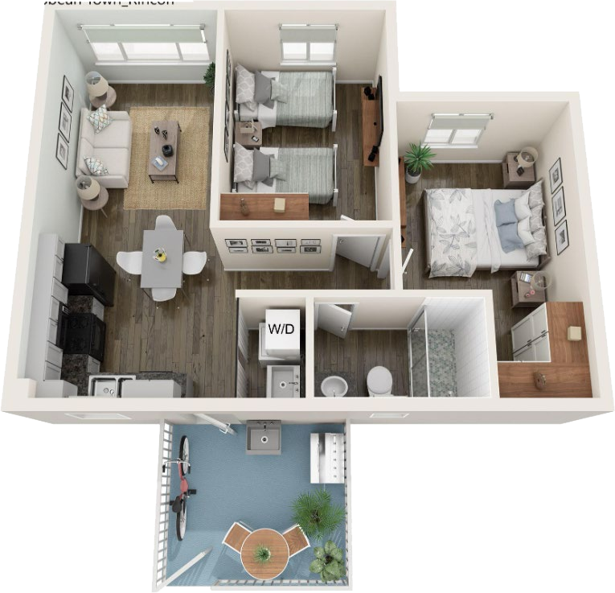
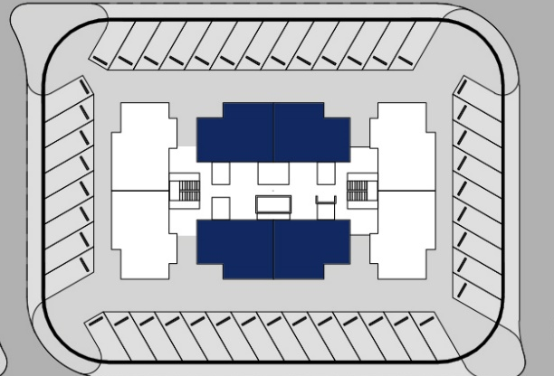
RINCON 2 bedroom + 1 bathroom Areas: Internal 59.40 m² Terrace 10.00 m² Parking 18.00 m² Total 87.40 m² Monthly HOA: AWG 604,47 / USD 345,41 Prices starting from: AWG 332.000 / USD 189.715

Slide 6
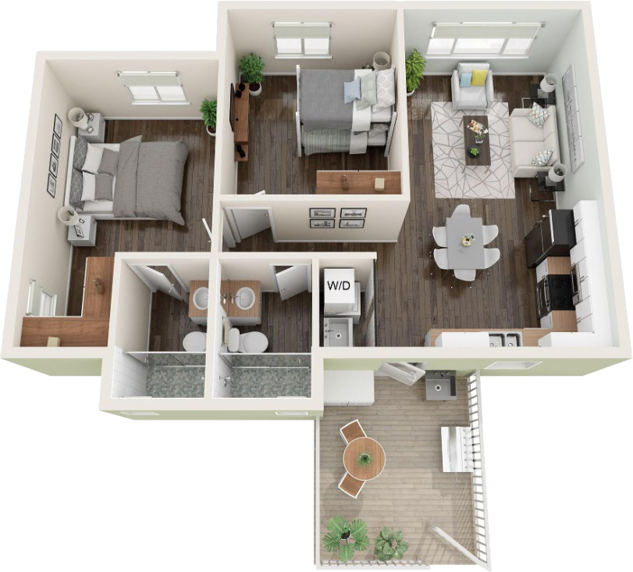
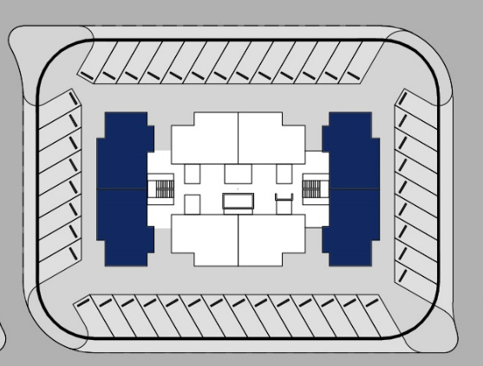
SAN JUAN 2 bedroom + 2 bathroom Areas: Internal 73.90 m² Terrace 11.50 m² Parking 18.00 m² Total 103.40 m² Monthly HOA AWG 726,03 / USD 414,87 Prices starting from: AWG 365.000 / USD 208.572

Slide 7
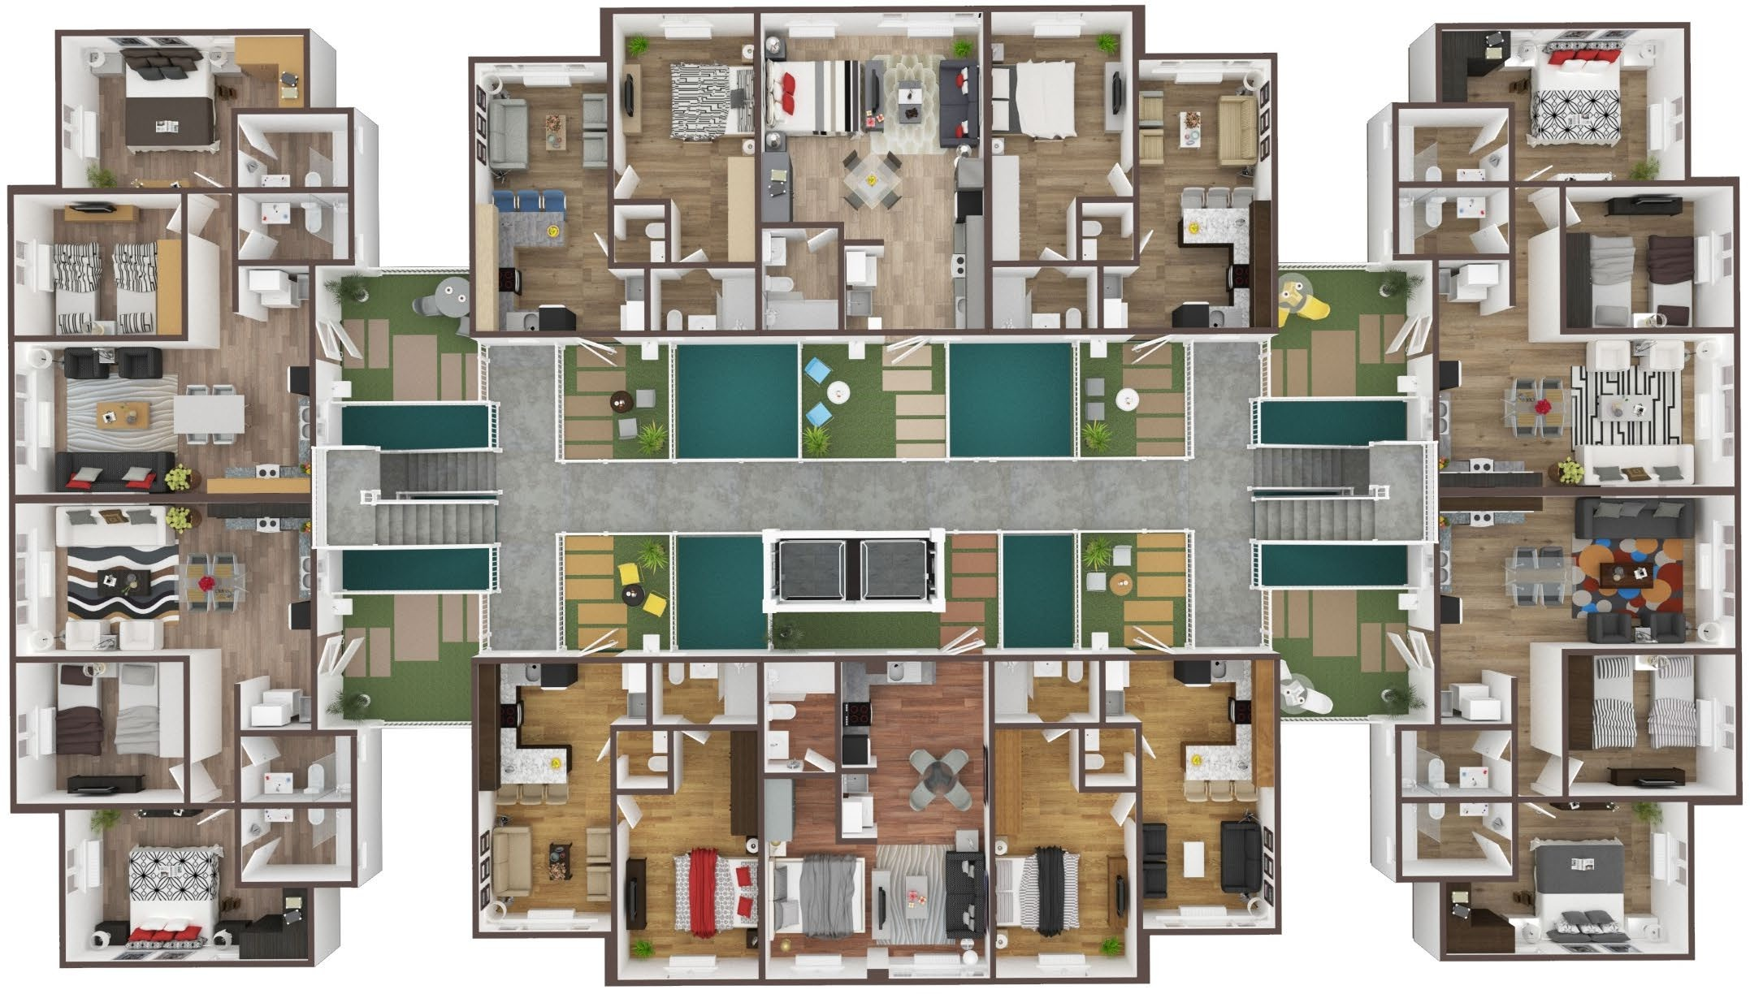
Guadeloupe Building Layout

Slide 8
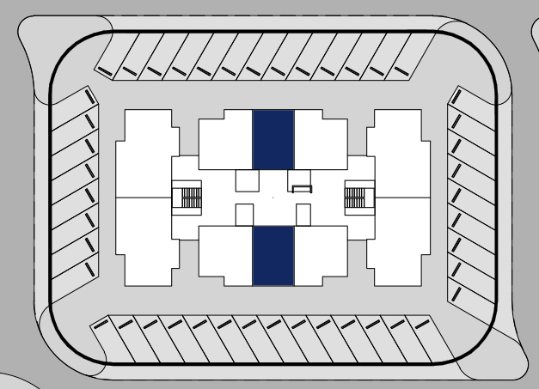
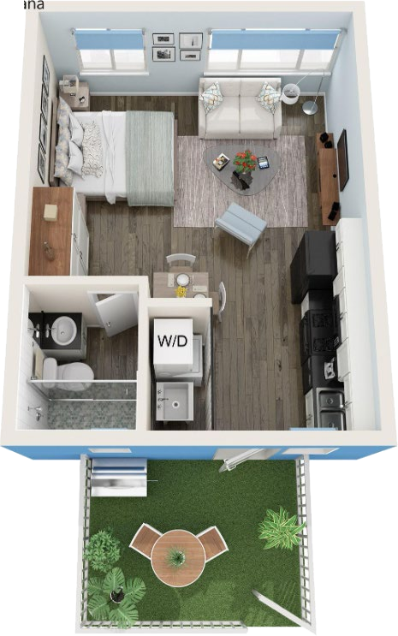
HAVANA
Studio
Areas: Internal 39.50m² Terrace 10.00 m Parking 18.00 m² Total 67.50 m² Monthly HOA: AWG 477,37 / USD 272,78 Prices starting from: AWG 234.000 / USD 133.715

Slide 9
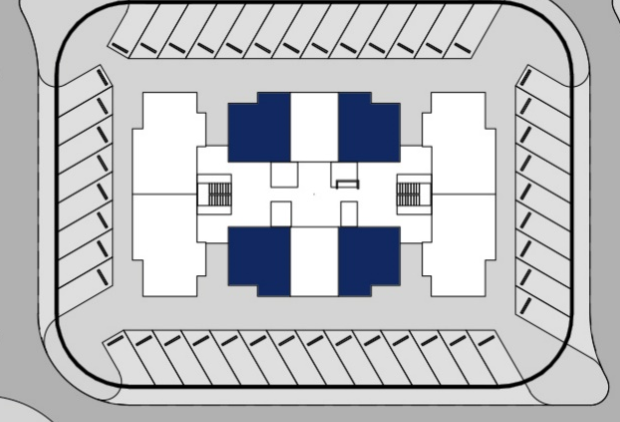
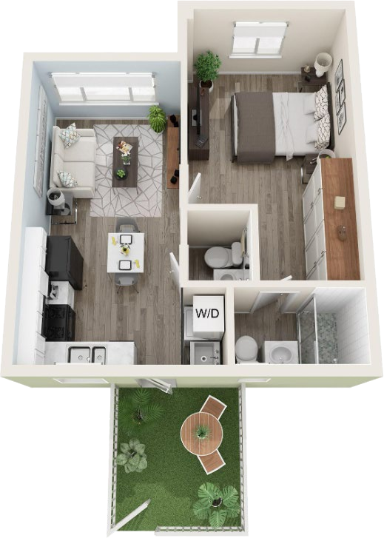
PUNTA CANA
1 Bedroom + 1,5 Bathroom
Areas: Internal 46.20m² Terrace 10.00 m Parking 18.00 m² Total 71.50 m² Monthly HOA: AWG 509,69 / USD 291,25 Prices starting from: AWG 257.000 / USD 146.858

Slide 10
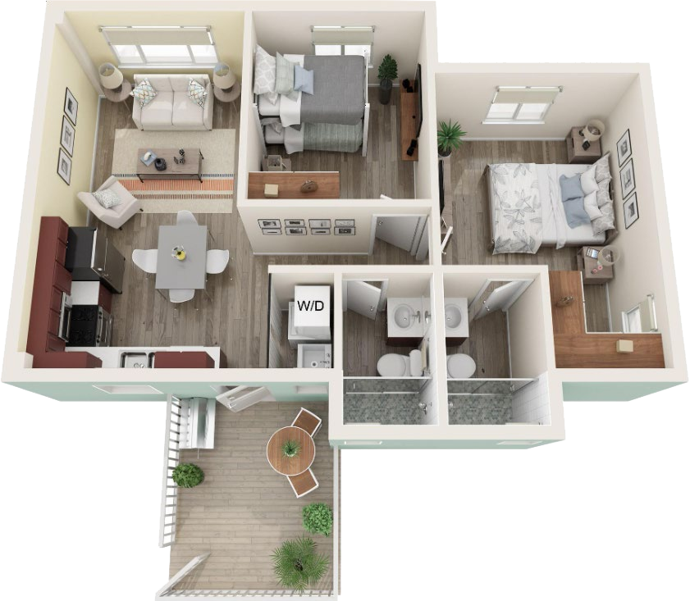
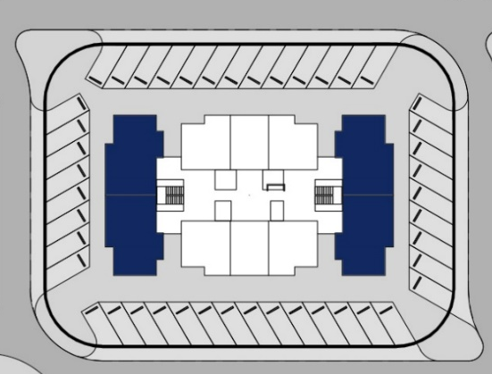
PORT AU PRINCE
2 Bedroom + 2 Bathroom
Areas: Internal 75.20m² Terrace 11.50 m Parking 18.00 m² Total 105.30 m² Monthly HOA: AWG 752,92 / USD 430,24 Prices starting from: AWG 375.000 / USD 214.286

Slide 11
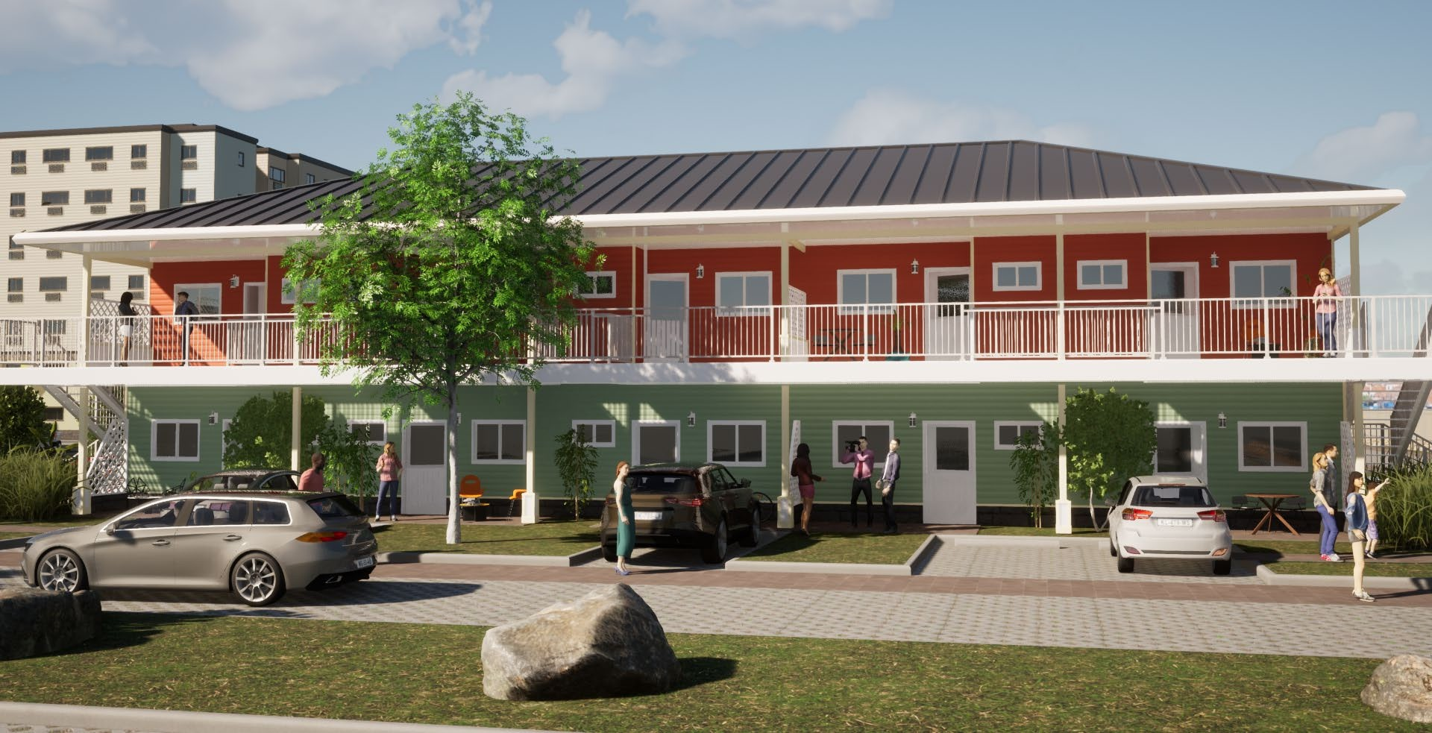
Townhouses

Slide 12
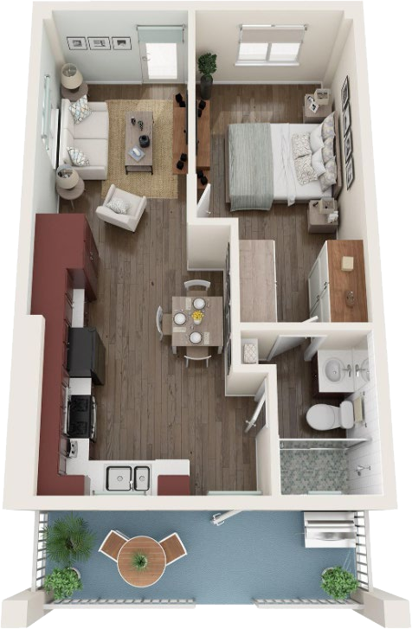
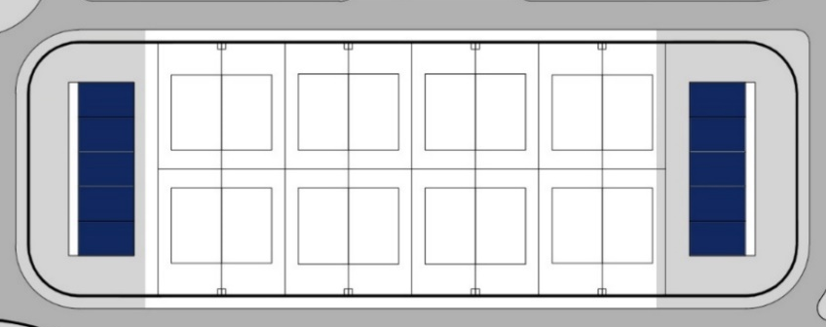
ST.JOHN I
1 Bedroom + 1 Bathroom
Areas: Internal 56.50 m² Terrace 22.00 m Parking 16.00 m² Total 72.50 m² Monthly HOA: AWG 673,55 / USD 384,89 Prices starting from: AWG 283.000 / USD 161.715

Slide 13
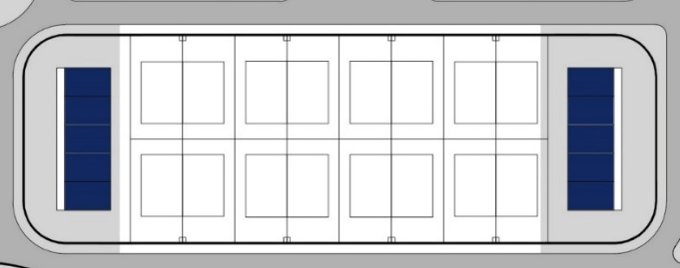
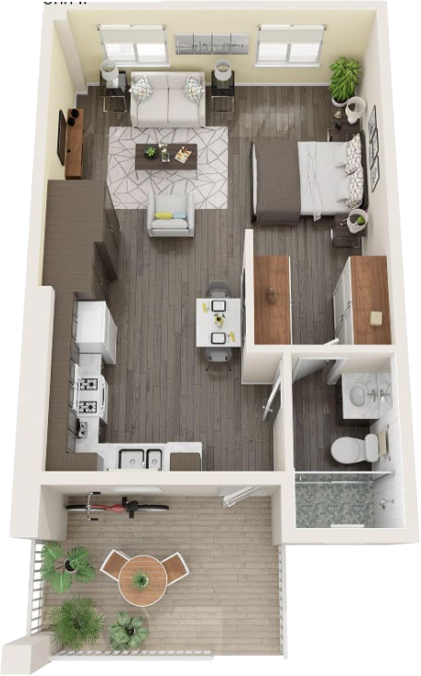
ST.JOHN II
Studio
Areas: Internal 48.00 m² Terrace 8.00 m² Parking 16.00 m² Total 72.00 m² Monthly HOA: AWG 565,16 / USD 322,95 Prices starting from: AWG 268.000 / USD 153.143

Slide 14
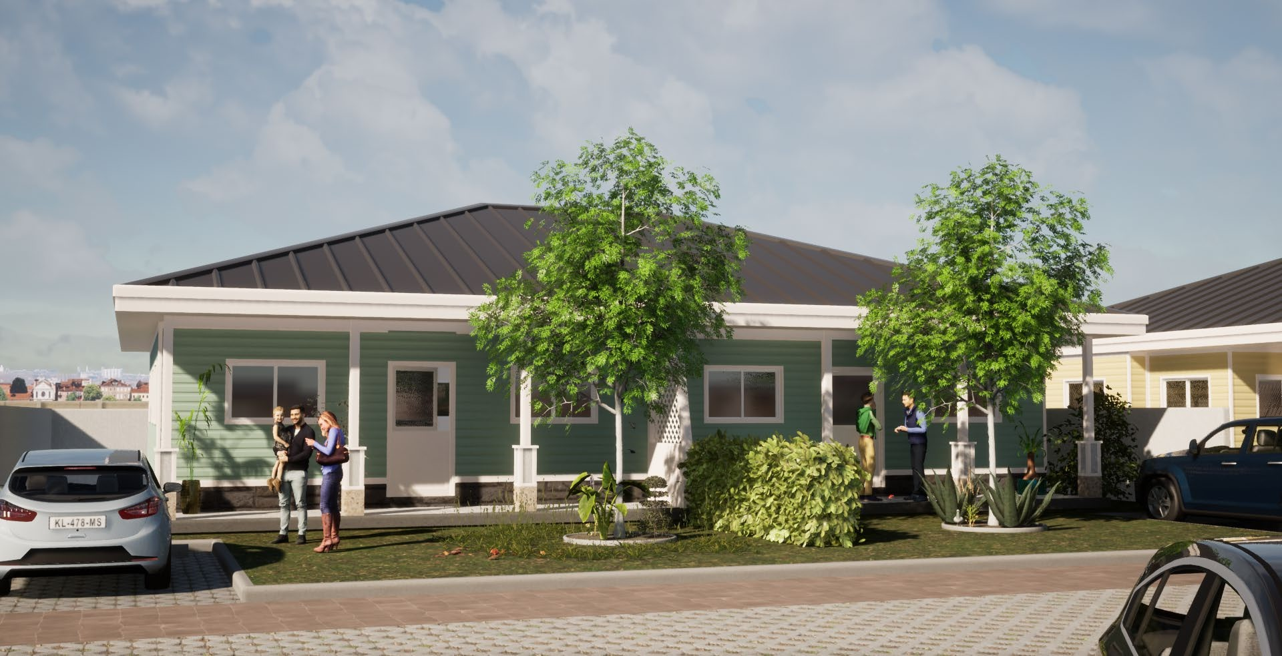
Villas

Slide 15
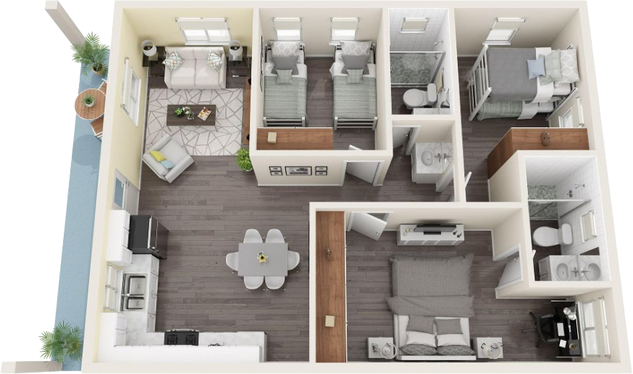
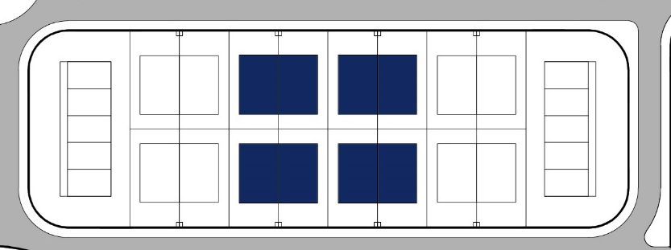
VILLA NASSAU
3 Bedroom + 2 Bathroom
Areas: Indoor+ Porch 90.00 m² Parking 24.00 m² Plot 200.00 m² Monthly HOA: AWG 1080,99 / USD 617,71 Prices starting from: AWG 490.000 / USD 280.000

Slide 16
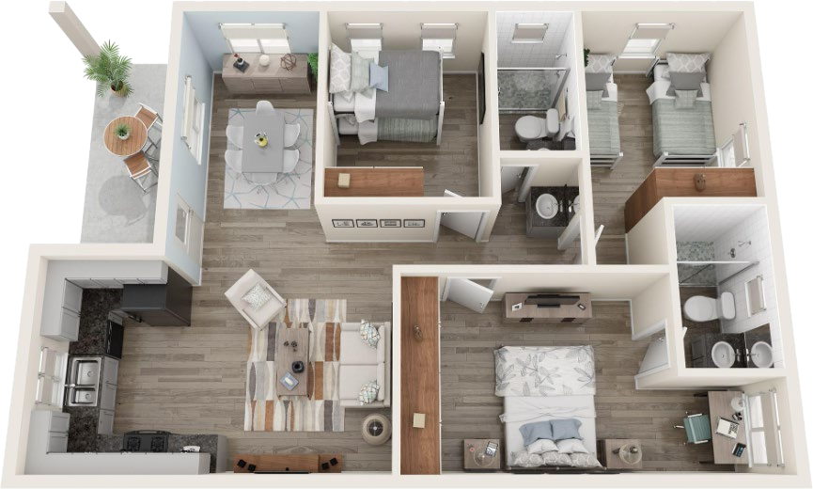
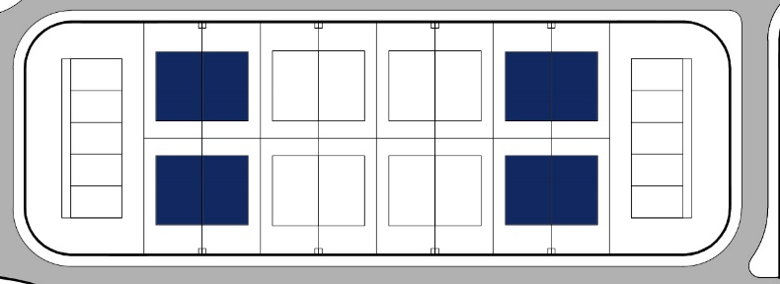
VILLA NEVIS
3 Bedroom + 2 Bathroom
Areas: Indoor+ Porch 91.00 m² Parking 24.00 m² Plot 200.00 m² Monthly HOA: AWG 1080,99 / USD 617,71 Prices starting from: AWG 490.000 / USD 280.000

Slide 17
PAYMENT PLAN
 |  | Payment 1 |  |  |  | Payment 2 |  |  |  | Payment 3
 |  | Event | Date | Payment (%) of the Purchase Price | On the Bank Account of | Event | Date | Payment (%) of the Purchase Price | On the Bank Account of | Event | Date | Payment (%) of the Purchase Price | On the Bank Account of
PAYMENT PLAN | A | Signing of the SPA | Day 1 | 10% | Notary | Signing of the Deed of Transfer | Delivery of the Dwelling | 90% | Notary | - | - | - | -
 | B | Signing of the SPA | Day 1 | 10% | Notary | Signing of the Deed of Transfer | Delivery of the Dwelling | 65% | Notary | - | - | - | -
 |  |  |  | 25% | YAMBO
 |  |  |  | 35%
 | C | Signing of the SPA | Day 1 | 10% | Notary | Signing of the Deed of Transfer | Delivery of the Dwelling | 50% | Notary | - | - | - | -
 |  |  |  | 40% | YAMBO
 |  |  |  | 50%
 | D | Signing of the SPA | Day 1 | 10% | Notary | Under Construction | Before Day 120 | 40% | YAMBO | Signing of the Deed of Transfer | Delivery of the Dwelling | 10% | Notary
 |  |  |  | 40% | YAMBO
 |  |  |  | 50%

Slide 18
DISCOUNT POLICY

Slide 19
Questions ?

